Slide 1
Microprocessor BSc CSIT II SEM
Basic Computer Architecture
Chapter Two
Bijay Babu Regmi
bijay.regmi@deerwalk.edu.np

Slide 2
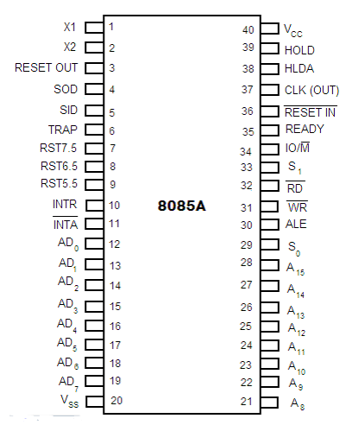
Pin Diagram of 8085
This 8085 is a 40-pin microprocessor where
these are categorized into seven groups.
With the below 8085 microprocessor pin diagram,
the functionality and purpose can be known easily.

Slide 3
Data Bus
The pins from 12 to 17 are the data bus pins which are AD₀ – AD₇, this carries the minimal considerable 8-bit data and address bus.
Address Bus
The pins from 21 to 28 are the data bus pins which are A₈ – A₁₅, this carries the most considerable 8-bit data and address bus.
Status and the Control Signals
In order to find out the behavior of the operation, these signals are mainly considered. In the 8085 devices, there are 3 each the control and status signals.
RD – This is the signal used for the regulation of READ operation. When the pin moves into low, it signifies that the chosen memory is read.
WR – This is the signal used for the regulation of WRITE operation. When the pin moves into low, it signifies that the data bus information is written to the chosen memory location.
ALE – ALE corresponds to Address Latch Enable signal. The ALE signal is high at the time of the machine’s initial clock cycle and this enables the last 8 bits of the address to get latched with the memory or external latch.

Slide 4
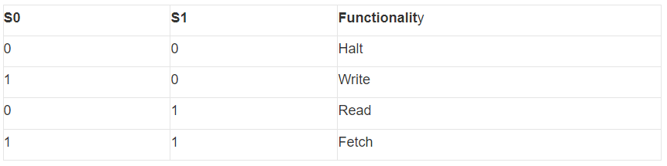
IO/M – This is the status signal that recognizes whether the address to be allotted for I/O or for memory devices.
READY – This pin is used to specify whether the peripheral is able to transfer information or not. When this pin is high, it transfers data and if this is low, the microprocessor device needs to wait until the pin goes to a high state.
S₀ and S₁ pins – These pins are the status signals which defines the below operations and those are:

Slide 5
Reset Signals
There are two reset pins which are Reset In and Reset Out at pins 3 and 36.
RESET IN – This pin signifies resetting the program counter to zero. Also, this pin resets the HLDA flip-flops and IE pins. The control processing unit will be in a reset state till RESET is not triggered.
RESET OUT – This pin signifies that the CPU is in reset condition.
Serial Input/Output Signals
SID – This is the serial input data line signal. The information that is on this dateline is taken into the 7th bit of the ACC when the RIM functionality is performed.
SOD – This is the serial output data line signal. The ACC’s 7th bit is the output on the SOD data line when the SIIM functionality is performed.
Externally Initiated and Interrupts Signals
HLDA – This is the signal for HOLD acknowledgment that signifies the received signal of HOLD request. When the request is removed, the pin goes to a low state. This is the output pin.
HOLD – This pin indicates that the other device is in the need to utilize data and address buses. This is the input pin.
INTA – This pin is the interrupt acknowledgment that is directed by the microprocessor device after the receival of the INTR pin. This is the output pin.
INTR – This is the interrupt request signal. It has minimal priority when compared with other interrupt signals.

Slide 6
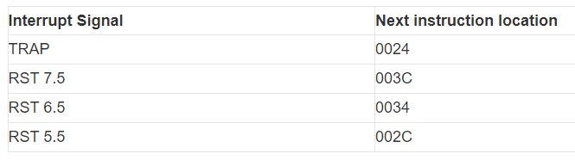
TRAP, RST 5.5, 6.5, 7.5 – These all are the input interrupt pins. When any one of the interrupt pins are recognized, then the next signal has functioned from the constant position in the memory based on the below table:
The priority list of these interrupt signals is
TRAP – Highest
RST 7.5 – High
RST 6.5 – Medium
RST 5.5 – Low
INTR – Lowest

Slide 7
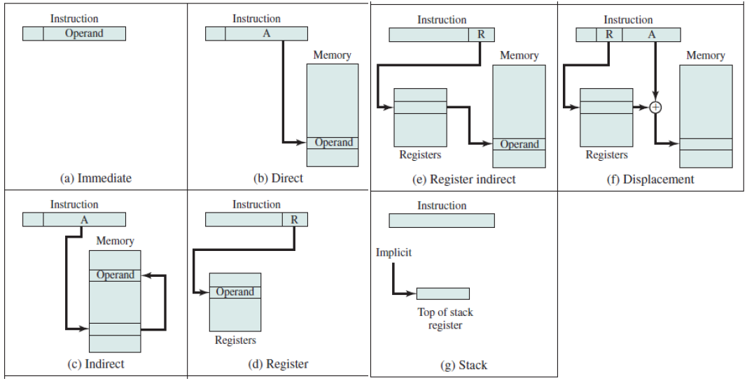
Addressing modes
refers to the way in which the operand of an instruction is specified
specifies a rule for interpreting or modifying the address field of the instruction before the operand is actually executed
most common addressing techniques or modes are:
1. Immediate
2. Direct
3. Indirect
4. Register
5. Register indirect
6. Displacement
7. Stack

Slide 8
Continued…
Immediate: In this mode, the operand is specified in the instruction itself. An immediate mode instruction has an operand field rather than the address field
Direct: effective address of operand is present in instruction itself. Single memory reference to access data
Indirect: the address field of instruction gives the address where the effective address is stored in memory
Register: similar to direct addressing except address field refers to a register rather than a main memory address
Register Indirect: the instruction specifies the register whose contents give us the address of operand which is in memory
Displacement: the contents of the indexed register is added to the Address part of the instruction, to obtain the effective address of operand. EA = A + (R)
Stack: operand is at the top of the stack. For example: ADD, this instruction will POP top two items from the stack, add them, and will then PUSH the result to the top of the stack.

Slide 9
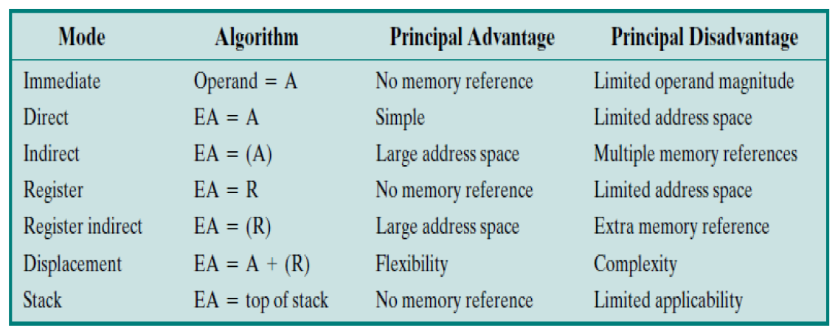
Continued…

Slide 10

Flag and Flag Register
Flags are a modified kind of register that record the condition of a microprocessor's calculation. For instance, a "zero status" flag is activated only when the microprocessor's calculation concludes with a "zero" status. The status of each flag determines the microprocessor's next action, thus enabling it to make decisions.
The Flag register is a Special Purpose Register. Depending upon the value of result after any arithmetic and logical operation the flag bits become set (1) or reset (0). In 8085 microprocessor, flag register consists of 8 bits and only 5 of them are useful.
The 5 flags are:

Slide 11
Sign Flag (S) – After any operation if the MSB (B(7)) of the result is 1, it indicates the number is negative and the sign flag becomes set, i.e. 1. If the MSB is 0, it indicates the number is positive and the sign flag becomes reset i.e. 0. from 00H to 7F, sign flag is 0 from 80H to FF, sign flag is 1
1- MSB is 1 (negative) 0- MSB is 0 (positive)
Zero Flag (Z) – After any arithmetical or logical operation if the result is 0 (00)H, the zero flag becomes set i.e. 1, otherwise it becomes reset i.e. 0. 00H zero flag is 1. from 01H to FFH zero flag is 0
1- zero result 0- non-zero result

Slide 12
Auxiliary Carry Flag (AC) – This flag is used in BCD number system(0-9). If after any arithmetic or logical operation D(3) generates any carry and passes on to B(4) this flag becomes set i.e. 1, otherwise it becomes reset i.e. 0. This is the only flag register which is not accessible by the programmer1-carry out from bit 3 on addition or borrow into bit 3 on subtraction 0-otherwise
Parity Flag (P) – If after any arithmetic or logical operation the result has even parity, an even number of 1 bits, the parity register becomes set i.e. 1, otherwise it becomes reset i.e. 0.1-accumulator has even number of 1 bits 0-accumulator has odd parity
Carry Flag (CY) – Carry is generated when performing n bit operations and the result is more than n bits, then this flag becomes set i.e. 1, otherwise it becomes reset i.e. 0. During subtraction (A-B), if A>B it becomes reset and if (A<B) it becomes set. Carry flag is also called borrow flag.
1-carry out from MSB bit on addition or borrow into MSB bit on subtraction 0-no carry out or borrow into MSB bit

Slide 13
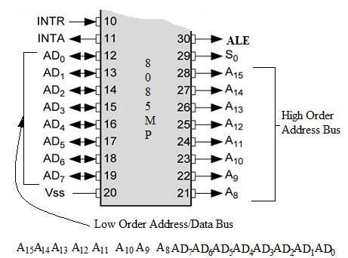
Multiplexing and De-Multiplexing of address and data bus
8085 is an 8-bit microprocessor an address a maximum of 2¹⁶ = 65536 memory location. It has a total of 16-pin on the package which will be used to carry both the address as well as the data. The low order address lines are multiplexed with 8-data lines and hence the pin 12 to 19 on the 8085 microprocessor IC are numbered as AD7 – AD0 (pin 12-19), whereas the high order bus is marked as A15 – A8 (pin 21-28) as shown in following cut-section diagram.
Figure: Multiplexed address data bus

Slide 14
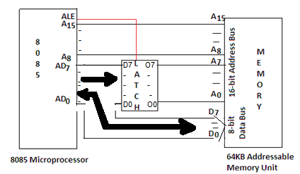
For accessing the memory full 16-bit address value must appear at once on pins A15 – A0 but the lower byte is not exclusively available to carry the address, it also carries the data. It is therefore required to de-multiplex the lower byte for address and data. An external latch can be used for this purpose.
Figure below shows the interfacing of memory with 8085 with the help of a latch. ALE signal is connected to the chip enable of the latch.
Figure: De-Multiplexing the address and data bus

Slide 15
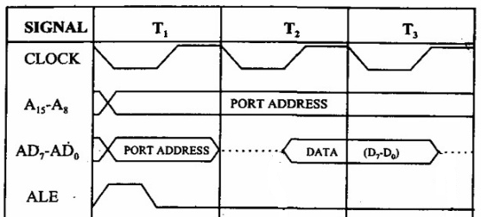
8085 microprocessor has a special pin 30 marked ALE (Address Latch Enable). A high signal on this pin is used to enable a latch. Thus the content on AD7 – AD0 (address) is latched at the output of the latch. The output of latch thus represent only address lines A7 – A0. When ALE goes low, same pins can now be used to carry the data to/from the memory.
Figure below shows the timing flow for demultiplexing the address and data bus.
Figure: Timing diagram for De-Multiplexing Address / Data Bus

Slide 16
The 16-bit address generated by the Microprocessor is placed as High byte (A15 – A8) on pin 21 – 28 and low order address on pin 12 – 19.
During timing cycle T0, microprocessor generates a short Low to High pulse on the ALE pin number 30, thus enabling the latch whose inputs are connected on AD7 – AD0 (PIN 12 to 19 of 8085).
Address now get latched on the output of the latch as A7 – A0.
After a while the ALE signal goes LOW and the address remains on the output side of the latch.
During timing cycle T1, the AD7 – D0 pins act as the data bus and can be used to carry the data (D7 – D0) to/from the memory.

Slide 17
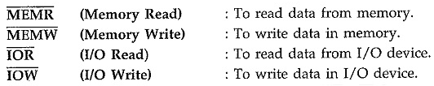
Generation of Control Signals
The 8085 Microprocessor provides RD and WR signals to initiate read or write cycle. Because these Control Signals of 8085 are used both for reading/writing memory and for reading/writing an input device, it is necessary to generate separate read and write signals for memory and I/O devices.
The 8085 provides IO/M signal to indicate whether the initiated cycle is for I/O device or for memory device. Using IO/M signal along with RD and WR, it is possible to generate separate four Control Signals of 8085 :

Slide 18
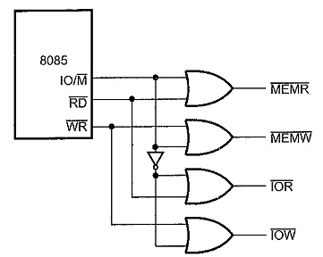
Fig. below shows the circuit which generates MEMR, MEMW, IOR and IOW signals.
Figure: Generation of MEMR, MEMW, IOR and IOW signals

Slide 19
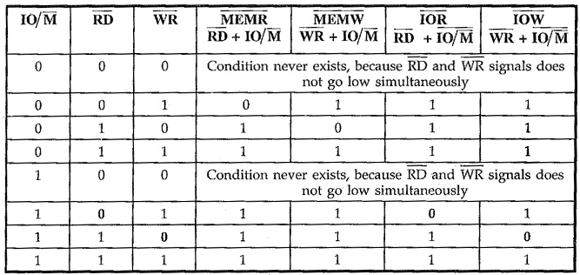
Table below shows the truth table used to generate MEMR, MEMW, IOR and IOW signals. The signal IO/M goes low for memory operation. This signal is logically ORed with RD and WR to get MEMR and MEMW signals. When both RD and IO/M signals go low, MEMR signal goes low.
Similarly, when both WR and IO/M Signals go low, MEMW signal goes low. To generate IOR and IOW signals for I/O operation, IO/M signal is first inverted and then logically ORed with RD and WR signals.

Slide 20
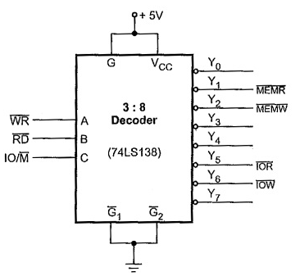
Same truth table can be implemented using 3:8 decoder as shown in Fig. below.
Figure: Generation of Control signals using 3:8 decoder

Slide 21
8086 Microprocessor
8086 Microprocessor is an enhanced version of 8085 Microprocessor that was designed by Intel in 1976. It is a 16-bit Microprocessor having 20 address lines and 16 data lines that provides up to 1MB storage. It consists of powerful instruction set, which provides operations like multiplication and division easily.
It supports two modes of operation, i.e. Maximum mode and Minimum mode. Maximum mode is suitable for system having multiple processors and Minimum mode is suitable for system having a single processor.
8086 does not have a RAM or ROM inside it. However, it has internal registers for storing intermediate and final results and interfaces with memory located outside it through the System Bus.
The size of the internal registers(present within the chip) indicates how much information the processor can operate on at a time (in this case 16-bit registers) and how it moves data around internally within the chip, sometimes also referred to as the internal data bus.

Slide 22
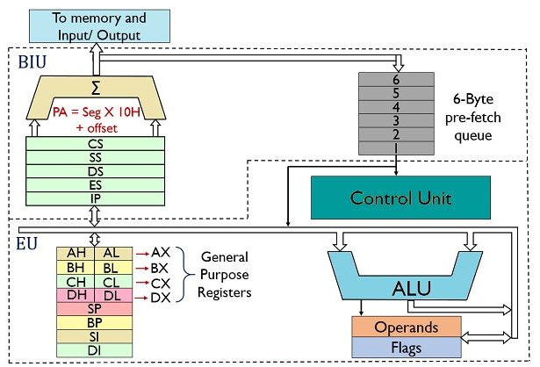
Logical Block Diagram of 8086
The architecture of 8086 microprocessor is composed of 2 major units, the BIU i.e., Bus Interface Unit and EU i.e., Execution Unit. The figure below shows the block diagram of the architectural representation of the 8086 microprocessor:
Figure: Logical Block Diagram of 8086

Slide 23
In the 8086 Microprocessor, the registers are categorized into mainly four types:
General Purpose Registers
Segment Registers
Pointers and Index Registers
Flag or Status Register
General Purpose Registers
The use of general-purpose registers is to store temporary data. While the instructions are executed in the control unit, they may work on some numeric value or some operands. These need to be stored somewhere so that the processor can operate on them easily. So, these registers are used in these cases. There are 4 general-purpose registers of 16-bit length each. Each of them is further divided into two subparts of 8-bit length each: one high, which stores the higher-order bits and another low which stores the lower order bits.
AX = [AH:AL]
BX = [BH:BL]
CX = [CH:CL]
DX = [DH:DL]

Slide 24
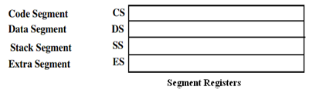
Segment Registers
There are four 16-bit segment registers namely code segment register(CS),Stack segment register(SS),Data segment register(DS) and Extra segment register(ES).
The code segment register is used for addressing the 64kB memory location in the code segment of the memory ,where the code of the executable program is stored.
Similarly the DS register points to the data segment of the 64kB memory where the data is stored.
The Extra segment register also refers to essentially another data segment of the memory space.
The SS register is useful for addressing stack segment of memory.
So, the CS,DS,SS and ES segment registers respectively contains the segment addresses for the code, data, stack and extra segments of the memory.

Slide 25
CS (Code Segment)
Code segment (CS) is a 16-bit register containing address of 64 KB segment with processor instructions. The processor uses CS segment for all accesses to instructions referenced by instruction pointer (IP) register. CS register cannot be changed directly. The CS register is automatically updated during far jump, far call and far return instructions.
Stack segment (SS)
Stack segment is a 16-bit register containing address of 64KB segment with program stack. By default, the processor assumes that all data referenced by the stack pointer (SP) and base pointer (BP) registers is located in the stack segment. SS register can be changed directly using POP instruction.
Data segment (DS)
Data segment is a 16-bit register containing address of 64KB segment with program data. By default, the processor assumes that all data referenced by general registers (AX, BX, CX, DX) and index register (SI, DI) is located in the data segment. DS register can be changed directly using POP and LDS instructions.

Slide 26
Extra segment (ES)
Extra segment is a 16-bit register containing address of 64KB segment, usually with program data. By default, the processor assumes that the DI register references the ES segment in string manipulation instructions. ES register can be changed directly using POP and LES instructions. It is possible to change default segments used by general and index registers by prefixing instructions with a CS, SS, DS or ES prefix.
IP (Instruction Pointer)
To access instructions the 8086 uses the registers CS and IP. The CS register contains the segment number of the next instruction and the IP contains the offset. IP is updated each time an instruction is executed so that it will point to the next instruction. Unlike other registers the IP can’t be directly manipulated by an instruction, that is, an instruction may not contain IP as its operand.

Slide 27
Pointers and Index Registers
The pointers will always store some address or memory location. In 8086 Microprocessor, they usually store the offset through which the actual address is calculated.
Instruction Pointer (IP): The instruction pointer usually stores the address of the next instruction that is to be executed. Apart from this, it also acts as an offset for CS register.
Base Pointer (BP): The Base pointer stores the base address of the memory. Also, it acts as an offset for Stack Segment (SS).
Stack Pointer (SP): The Stack Pointer points at the current top value of the Stack. Like the BP, it also acts as an offset to the Stack Segment (SS). The indexes are used with the extra segment and they usually are used for copying the contents of a particular block of memory to a new location.
Source Index (SI): It stores the offset address of the source.
Destination Index (DI): It stores the offset address of the Destination.

Slide 28
Flag or Status Register
The Flag or Status register is a 16-bit register which contains 9 flags, and the remaining 7 bits are idle in this register. These flags tell about the status of the processor after any arithmetic or logical operation. IF the flag value is 1, the flag is set, and if it is 0, it is said to be reset.

Slide 29
Memory Segmentation:
Memory segmentation is nothing which is the methods where whole memory is divided into the smaller parts.
In 8086 microprocessor memory are divided into four parts which is known as the segments. These segments are data segment, code segment, stack segment and extra segment.
The total memory size is divided into segments of various sizes. A segment is just an area in memory. The process of dividing memory this way is called Segmentation.
In memory, data is stored as bytes. Each byte has a specific address. Intel 8086 has 20 lines address bus. With 20 address lines, the memory that can be addressed is 2²⁰ bytes. 2²⁰ = 1,048,576 bytes (1 MB).
8086 can access memory with address which ranges fro m 0 0 0 0 H t o FFFFFH

Slide 30
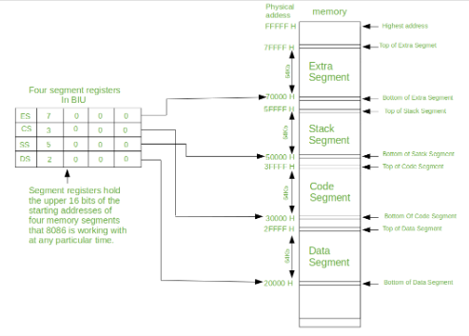
Note that the 8086 does not work the whole 1MB memory at any given time. However it works only with four 64KB segments within the whole 1MB memory.
Bellow is the one way of positioning four 64 kilobyte segments within the 1M byte memory space of an 8086.

Slide 31
Types of Segmentation:
Overlapping Segment – A segment starts at a particular address and its maximum size can go up to 64kilobytes. But if another segment starts along this 64kilobytes location of the first segment, then the two are said to be Overlapping Segment.
Non-Overlapped Segment – A segment starts at a particular address and its maximum size can go up to 64kilobytes. But if another segment starts before this 64kilobytes location of the first segment, then the two segments are said to be Non-Overlapped Segment.

Slide 32
Bus Interface Unit
It provides a full 16 bit bidirectional data bus and 20 bit address bus.
The bus interface unit is responsible for performing all external bus operations.
Specifically it has the following functions:
Instruction fetch, Instruction queuing, Operand fetch and storage, Address relocation and Bus control.
The BIU uses a mechanism known as an instruction stream queue to implement pipeline architecture.
This queue permits pre fetch of up to six bytes of instruction code. Whenever the queue of the BIU is not full, it has room for at least two more bytes and at the same time the EU is not requesting it to read or write operands from memory, the BIU is free to look ahead in the program by prefetching the next sequential instruction.
These prefetching instructions are held in its FIFO queue. With its 16 bit data bus, the BIU fetches two instruction bytes in a single memory cycle.
After a byte is loaded at the input end of the queue, it automatically shifts up through the FIFO to the empty location nearest the output.
The EU accesses the queue from the output end. It reads one instruction byte after the other from the output of the queue. If the queue is full and the EU is not requesting access to operand in memory.

Slide 33
These intervals of no bus activity, which may occur between bus cycles are known as Idle state.
If the BIU is already in the process of fetching an instruction when the EU request it to read or write operands from memory or I/O, the BIU first completes the instruction fetch bus cycle before initiating the operand read / write cycle.
The BIU also contains a dedicated adder which is used to generate the 20bit physical address that is output on the address bus. This address is formed by adding an appended 16 bit segment address and a 16 bit offset address.
For example: The physical address of the next instruction to be fetched is formed by combining the current contents of the code segment CS register and the current contents of the instruction pointer IP register.
The BIU is also responsible for generating bus control signals such as those for memory read or write and I/O read or write.

Slide 34
Execution Unit
The Execution unit is responsible for decoding and executing all instructions.
The EU extracts instructions from the top of the queue in the BIU, decodes them, generates operands if necessary, passes them to the BIU and requests it to perform the read or write by cycles to memory or I/O and perform the operation specified by the instruction on the operands.
During the execution of the instruction, the EU tests the status and control flags and updates them based on the results of executing the instruction.
If the queue is empty, the EU waits for the next instruction byte to be fetched and shifted to top of the queue.
When the EU executes a branch or jump instruction, it transfers control to a location corresponding to another set of sequential instructions.
Whenever this happens, the BIU automatically resets the queue and then begins to fetch instructions from this new location to refill the queue.

Slide 35
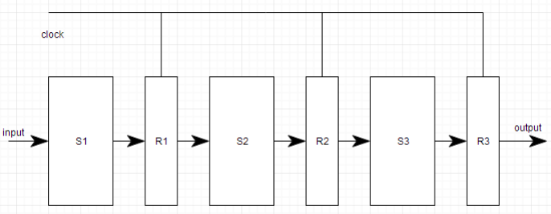
Pipelining
Pipelining is the process of accumulating instruction from the processor through a pipeline. It allows storing and executing instructions in an orderly process. It is also known as pipeline processing.
Pipelining is a technique where multiple instructions are overlapped during execution. Pipeline is divided into stages and these stages are connected with one another to form a pipe like structure. Instructions enter from one end and exit from another end.
It increases the overall instruction throughput. In pipeline system, each segment consists of an input register followed by a combinational circuit. The register is used to hold data and combinational circuit performs operations on it. The output of combinational circuit is applied to the input register of the next segment.

Slide 36

It is divided into 2 categories:
Arithmetic Pipeline
Instruction Pipeline
Arithmetic Pipeline
Arithmetic pipelines are usually found in most of the computers. They are used for floating point operations, multiplication of fixed point numbers etc. For example: The input to the Floating Point Adder pipeline is:
Here A and B are mantissas (significant digit of floating point numbers), while a and b are exponents. The floating point addition and subtraction is done in 4 parts:
Compare the exponents. 2. Align the mantissas. 3. Add or subtract mantissas 4. Produce the result.
Registers are used for storing the intermediate results between the above operations.

Slide 37
Instruction Pipeline
In this a stream of instructions can be executed by overlapping fetch, decode and execute phases of an instruction cycle. This type of technique is used to increase the throughput of the computer system.
An instruction pipeline reads instruction from the memory while previous instructions are being executed in other segments of the pipeline. Thus we can execute multiple instructions simultaneously. The pipeline will be more efficient if the instruction cycle is divided into segments of equal duration.

Slide 38
Four Segment Instruction Pipeline
Pipeline processing can occur not only in the data stream but in the instruction stream as well.
Most of the digital computers with complex instructions require instruction pipeline to carry out operations like fetch, decode and execute instructions.
In general, the computer needs to process each instruction with the following sequence of steps.
Fetch instruction from memory.
Decode the instruction.
Calculate the effective address.
Fetch the operands from memory.
Execute the instruction.
Store the result in the proper place.
Each step is executed in a particular segment, and there are times when different segments may take different times to operate on the incoming information. Moreover, there are times when two or more segments may require memory access at the same time, causing one segment to wait until another is finished with the memory.

Slide 39
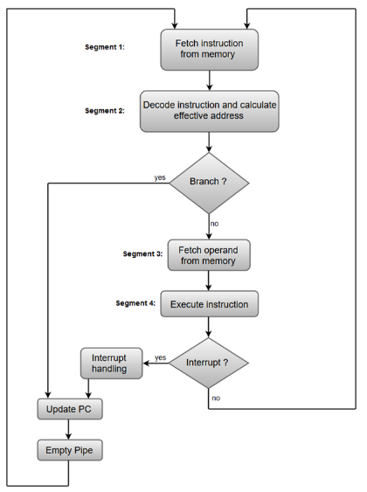
A four-segment instruction pipeline combines two or more different segments and makes it as a single one. For instance, the decoding of the instruction can be combined with the calculation of the effective address into one segment.
The following block diagram shows a
typical example of a four-segment instruction
pipeline. The instruction cycle is completed in
four segments.

Slide 40
Segment 1:
The instruction fetch segment can be implemented using first in, first out (FIFO) buffer.
Segment 2:
The instruction fetched from memory is decoded in the second segment, and eventually, the effective address is calculated in a separate arithmetic circuit.
Segment 3:
An operand from memory is fetched in the third segment.
Segment 4:
The instructions are finally executed in the last segment of the pipeline organization.

Slide 41
Assignment 2
Explain Vector (Array) processing and Superscalar Processor.
What are the pipelining hazards? Explain.

